Slide 1

HEMWATI NANDAN BAHUGUNA GARHWAL UNIVERSITY
(A Central University)
Project on
“Website Based On Uttrakhand”
Department of Computer Science and Engineering School Of Engineering and Technology
Guided By:
Dr Om Prakash
Presented By: Rachit Panwar
MCA 4th Sem
Roll No. 20134708030

Slide 2
TOPICS
01. Introduction
02. Features
03. Tools and Technology
04. Functionality and User Right Diagram
05. Modules and Internal Structure
06. Snapshots
07. Conclusion
08. References

Slide 3
01
INTRODUCTION

Slide 4
Introduction
Bedpakubarmasa.com is a website to handle trainees and their respective data.
This system enables smooth and reliable communication between people, mentors and learner.
This system has built-in learning culture system that enables people to learn and grow with there culture.

Slide 5
02
FEATURES

Slide 6
Features
To establish a network and develop cooperation among people with origin in Uttarakhand working in tourism sector in different parts of the country with an aim of creating new job opportunities for them.
To conduct, encourage and promote studies and research in the field of Yoga, Meditation, Nature care etc.
To provide all types of assistance and opportunities to children and young artistes from Uttarakhand.
To provide entrepreneurship and skill development training in the field of tourism to socially and economically weaker sections of population for self-employment.

Slide 7
03
TOOLS AND TECHNOLOGY STACK

Slide 8


Tools and technology stack
Language:
Php (For Backend)
HTML, CSS, JavaScript
(For Frontend)
Platform :
vs code
PHP is a server scripting language, and a powerful tool for making dynamic and interactive Web pages.
PHP is a widely-used, free, and efficient alternative to competitors such as Microsoft's ASP.
HTML provides the structure of the page, CSS the (visual and aural) layout, for a variety of devices. Along with graphics and scripting, HTML and CSS are the basis of building Web pages and Web Applications. HTML is the language for describing the structure of Web pages.
08

Slide 9
04
Dfd of website

Slide 10
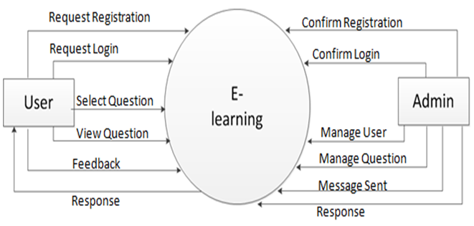
DFD Diagram

Slide 11
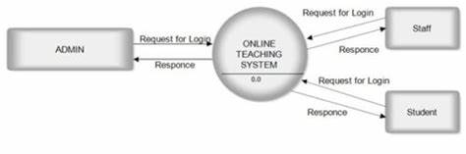

Slide 12
05
MODULES AND INTERNAL STRUCTURE

Slide 13
Modules in this project
Home page
Navigation bar
Places and culture
places
cultures
login
signup
Learning it system
learning c++
learning c#

Slide 14
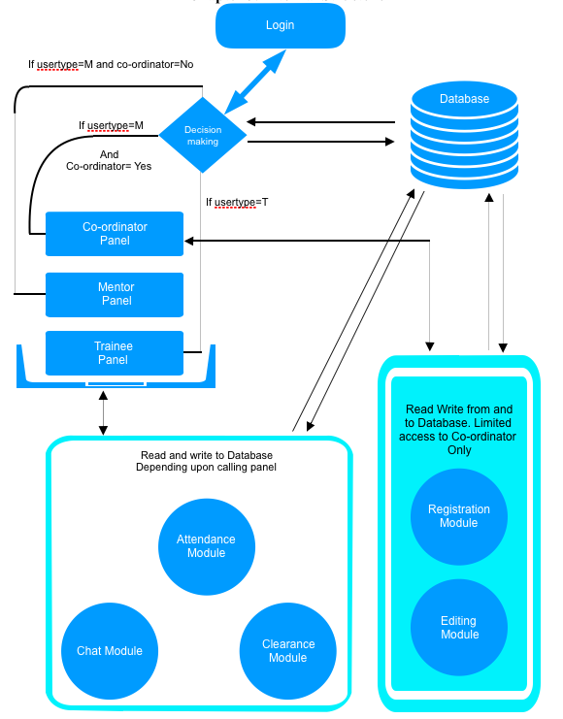
Internal Structure

Slide 15
06
SNAPSHOTS

Slide 16
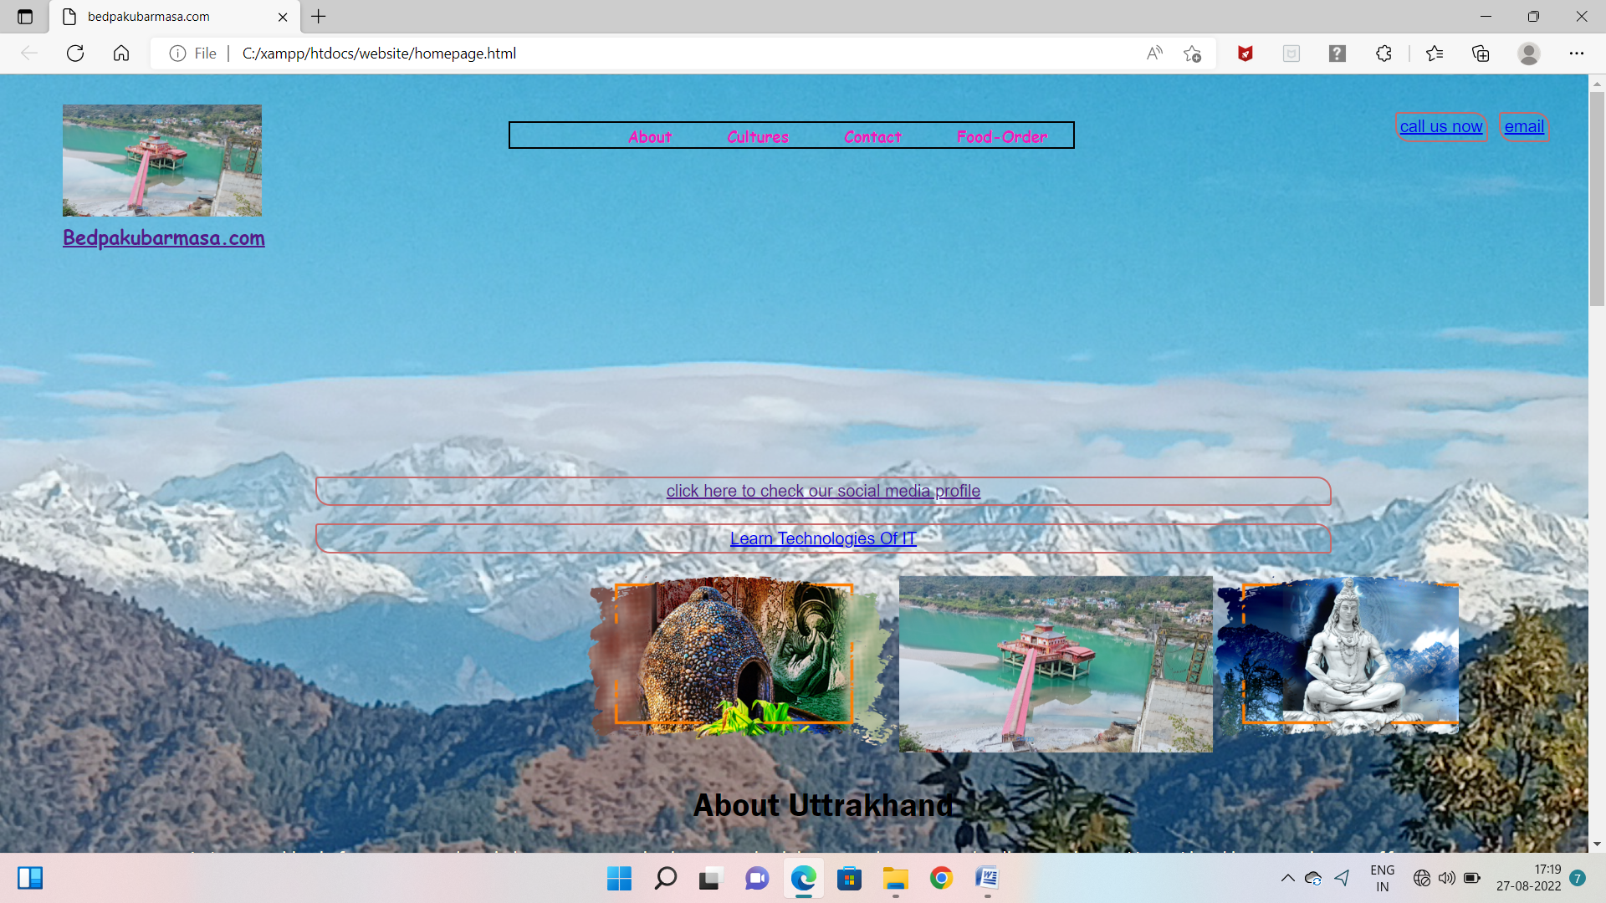
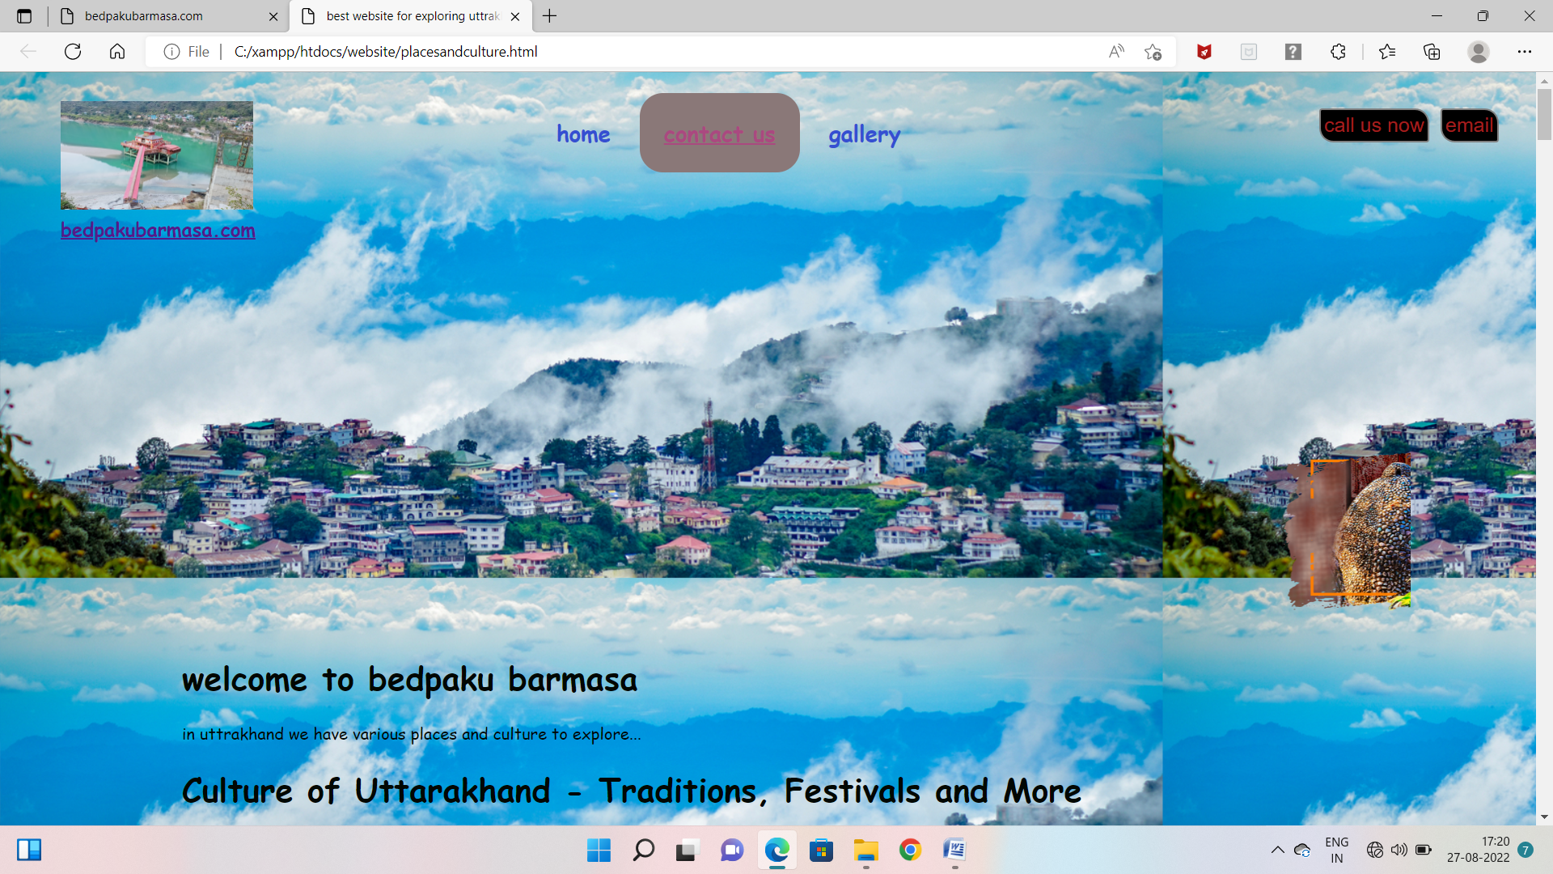
Snapshots
Home page
Contact us
15

Slide 17
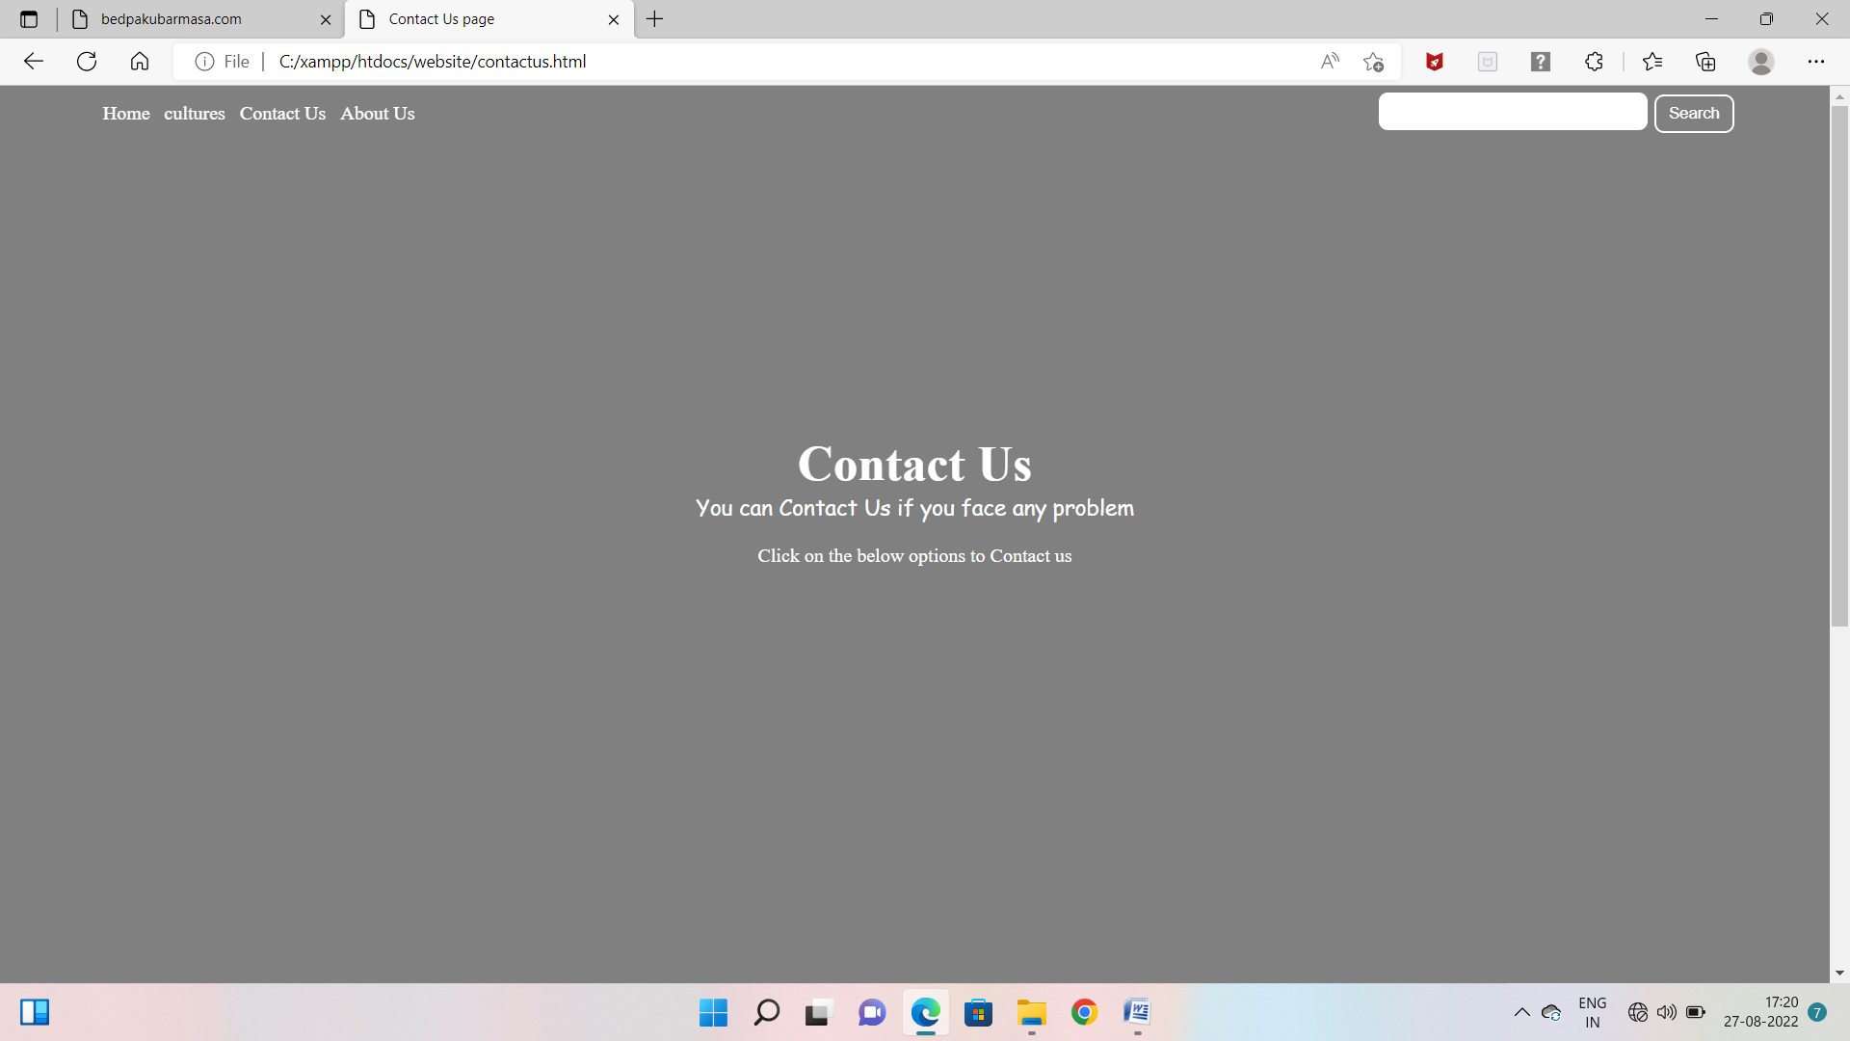
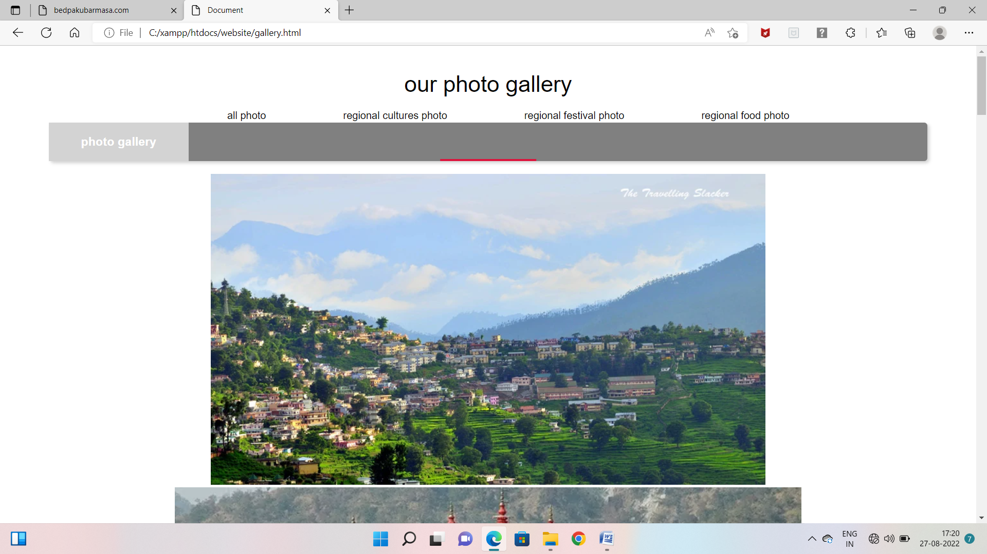
Snapshots
Contact us
Photo gallery
16

Slide 18
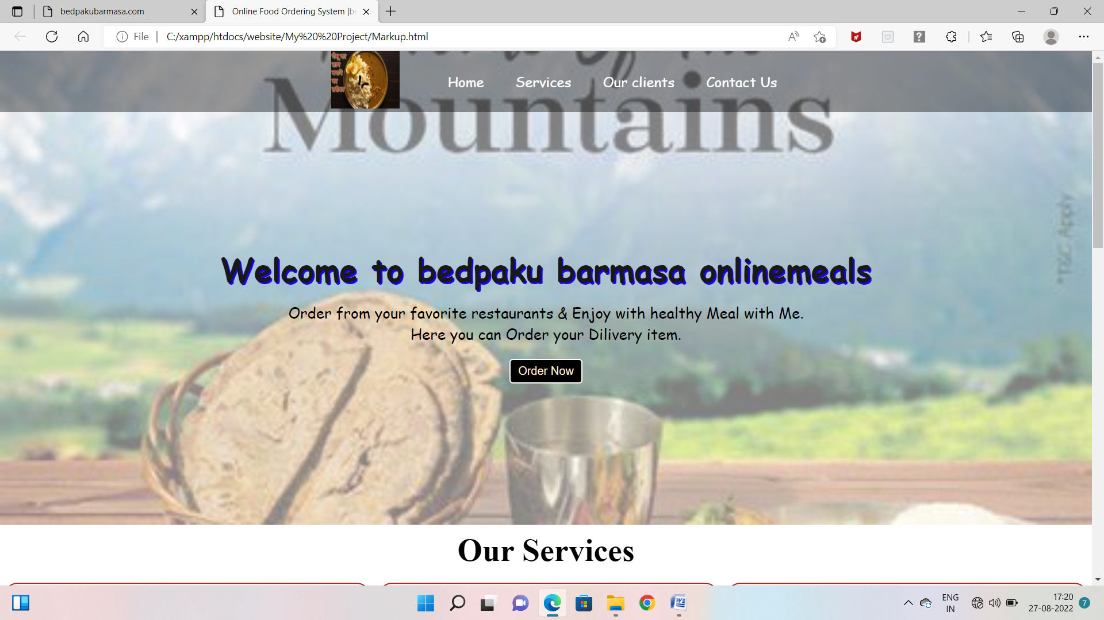
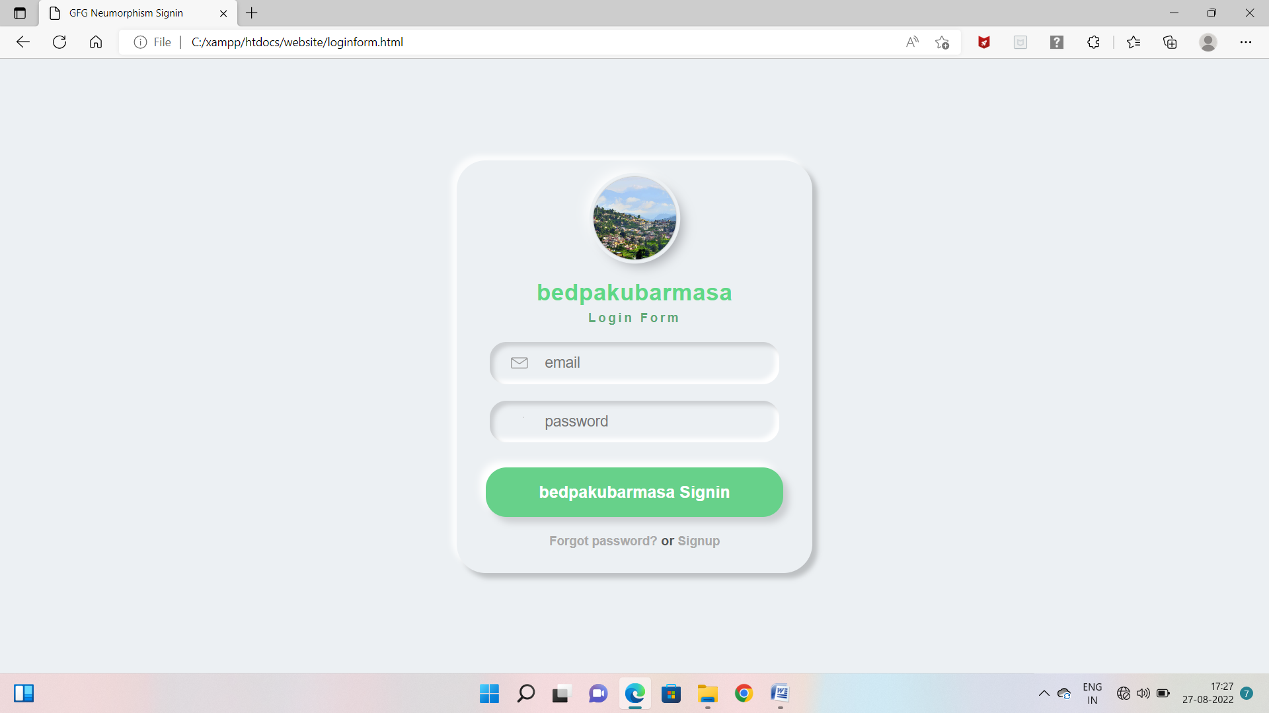
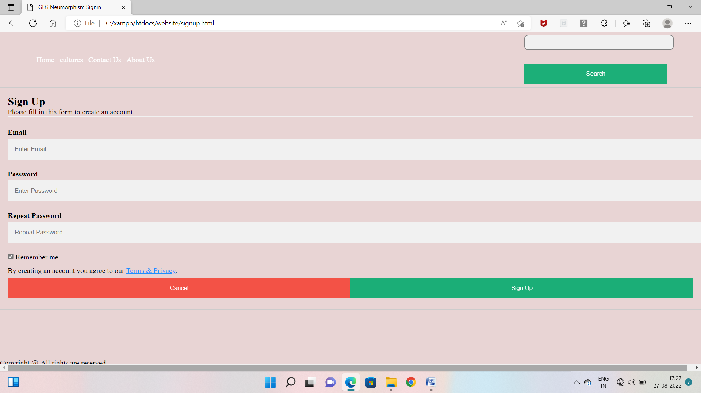
Snapshots
Online food order
Login page
Sign up page
17

Slide 19
07
CONCLUSION

Slide 20

CONCLUSION
It is concluded that the application works well and satisfy the company and user. The application is tested well and errors are properly debugged. The site is simultaneously accessed from more than one system. Simultaneously login from more than one place is tested.
This site works according to the restriction provided in their respective browser. Further enhancement can be made to the application, so that the web site functions very interactive and useful to existing application. The application satisfies both the company and user by eliminating more input. The speed of the transactions become more enough now.

Slide 21
08
REFERENCES

Slide 22
REFERENCES
Websites referred:-
https://www.w3schools.com
https://www.tutorialspoint.com
https://www.stackoverflow.com
https://www.codeacademy.com

Slide 23
THANK YOU!
Any questions?
You can find me at
rachitpanwar151@gmail.com

